Slide 1
“Towards the Development of a Land Degradation Baseline and Resource Mobilization Framework for the SADC Sub Regional Action Programme to Combat Desertification (SRAP)”
Presented by Titus Dlamini, IUCN Environmental Consultant
14 September 2017
UNCCD COP 13, Landscapes Restoration Day , Rio Pavillion

Slide 2
Presentation Outline
Background
The SADC SRAP
Aims & objectives of the Investment Framework
Methodology / process to be followed
SADC Land Degradation Baseline
Investment Framework:
Examples of Available Opportunities for Funding SADC Land Restoration

Slide 3
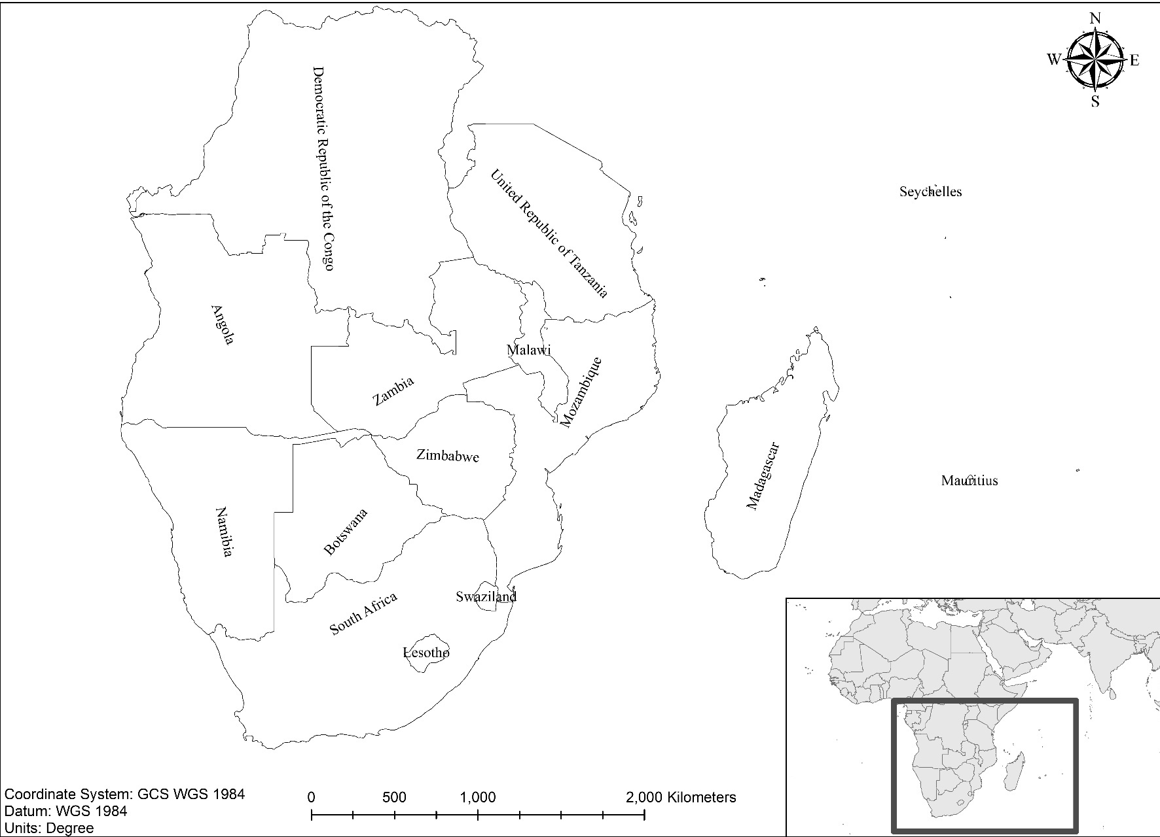
The Southern Africa Development Community (SADC)
15 member states and an approximate population of 280 million people which is growing at an average rate of 3%.
Experiences GDP growth of 5.14%, with a very significant part of the economy in the industrial (32% GDP) and service (51%) sectors.
These factors — population growth and industrialisation — converge to pose a number of significant threats on the region’s environment, including land degradation, depletion, loss of biodiversity, increasing frequencies of droughts, water stress, and dwindling production and productivity.

Slide 4
Methodology
Process Towards Development of LD Investment Framework
Literature review (cf. to other regional environment investment frameworks; existing environment related investment strategies within SADC).
Assessment of LD databases & data mapping
Determination of SADC LDN baseline using land cover, land productivity and SOC indicators.
SADC LD stakeholder assessment (NFPs - UNFCCC & UNCBD; Development partners; SADC Task Force); collection of inputs from stakeholders (NFPs UNCCD; Financial sector) through questionnaires
Interviews of selected stakeholders for their direct inputs
Assessment of land dynamics & current LD funding mechanism
Proposal of innovative financing mechanism

Slide 5
The SADC Sub-regional Action Programme to Combat Desertification (SRAP)
Adopted by SADC member states in November 2015 as a regional effort to address land degradation and combat desertification (The first generation was developed in 1997)
Complimentary to the Regional Biodiversity Strategy and Action Plan.
Provides a roadmap through which the SADC regional structures, Member States, relevant stakeholders and relevant partners can:
  Mobilise resources and work together to combat Desertification, Land Degradation and Drought (DLDD) and achieve Sustainable Development Goal (SDG) 15.3 on Land Degradation Neutrality (LDN);
  Shows the links between high level initiatives and policy frameworks which helps identify higher priorities; and Ipromotes transboundary initiatives

Slide 6
Aims and Objectives of the LD Investment Framework
To quantify and document resources that need to be mobilized to drive SADC SLM programmes
The framework will set protocols for defining a transparent method for setting SLM priorities for the sub region.
To create a platform for introduction of new SLM activities within SADC.
To document a roadmap for SADC DLDD pursuing financing needs from global, regional and national financing sources.
To identify possible barriers to accessing funds from the traditional sources in order to overcome them

Slide 7
Aims and Objectives of the LD Investment Framework
To find ways to improve the absorptive capacity for the sub region from traditional funding sources.
To facilitate introduction of land restoration programmes in the Sub Region.
To propose new innovative methods for funding LD in the Sub Region.
The framework will have specific, measurable, attainable and time LD targets hence it will assist the SADC Secretariat in accounting to DLDD stakeholders on the status of implementation of the SADC SRAP.
It will also facilitate communication between SADC and key partners such as land users and cooperating partners.

Slide 8
LAND COVER | AREA IN 2000 (HA) | AREA IN 2015 (HA) | NET AREA CHANGE (HA) | % CHANGE
Agriculture | 136,424,862 | 136,993,518 | 568,656 | 0.42%
Forest | 438,862,536 | 442,356,579 | 3,494,043 | 0.80%
Grassland | 120,094,542 | 119,783,988 | (310,554) | -0.26%
Shrubland | 208,051,164 | 205,483,140 | (2,568,024) | -1.23%
Sparse vegetation | 15,211,854 | 13,046,310 | (2,165,544) | -14.24%
Wetland | 15,620,823 | 15,962,769 | 341,946 | 2.19%
Settlement | 890,082 | 1,591,083 | 701,001 | 78.76%
Bare area | 21,348,864 | 21,433,338 | 84,474 | 0.40%
Water | 18,173,241 | 18,027,243 | (145,998) | -0.80%
Land cover trends within SADC
(2000 -2015)

Slide 9
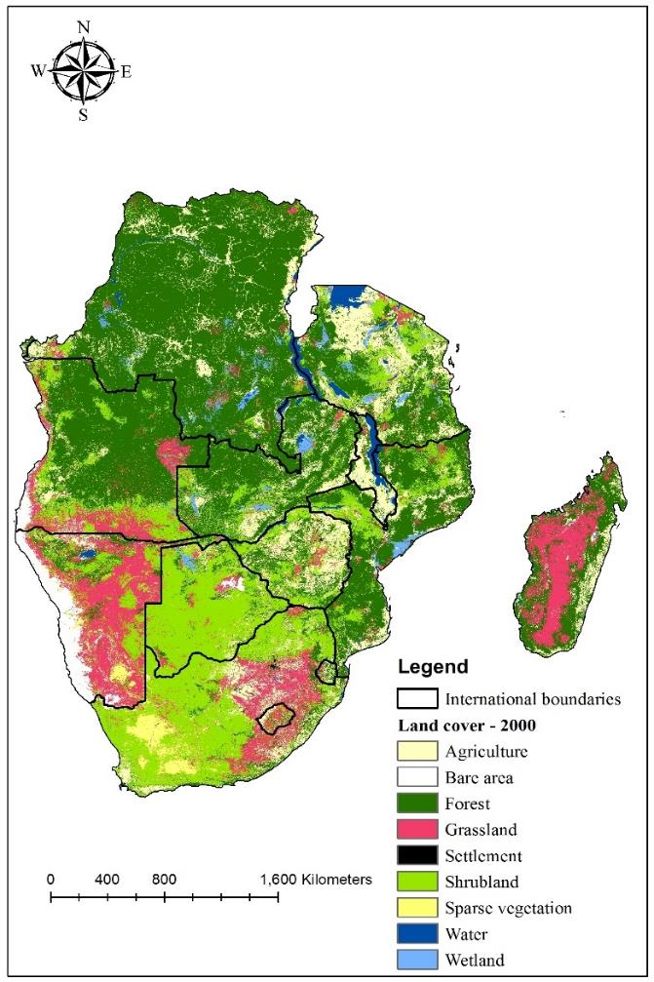

Land cover change between 2000 (left) and 2015 (right) within the SADC Sub-region

Slide 10
Land cover class | Land productivity dynamics class (sq. km) based on NDVI for 1999 to 2014
 | Declining | Early signs of decline | Stable but stressed | Stable not stressed | Increasing | No data
Agriculture | 10,249,344 | 14,812,011 | 11,494,521 | 76,866,237 | 22,955,427 | 614,538
Bare area | 1,932,687 | 1,151,217 | 368,631 | 6,790,734 | 161,865 | 11,017,548
Forest | 8,060,175 | 22,310,361 | 35,318,322 | 212,927,823 | 162,244,755 | 1,494,009
Grassland | 7,385,634 | 16,213,131 | 7,043,733 | 76,350,573 | 12,356,658 | 432,702
Settlement | 317,700 | 176,400 | 146,250 | 767,259 | 145,242 | 38,232
Shrubland | 26,361,999 | 34,773,165 | 11,549,259 | 109,128,924 | 22,587,714 | 1,077,273
Sparse vegetation | 1,770,147 | 1,262,628 | 1,132,443 | 8,363,070 | 47,106 | 468,099
Water | 433,647 | 185,850 | 323,487 | 1,985,625 | 537,435 | 14,560,794
Wetland | 1,083,510 | 961,488 | 1,242,774 | 6,549,732 | 5,468,778 | 656,487
Total (ha) | 57,594,843 | 91,846,251 | 68,619,420 | 499,729,977 | 226,504,980 | 30,359,682
Percentage of total land area | 5.9% | 9.4% | 7.0% | 51.3% | 23.2% | 3.1%

Slide 11
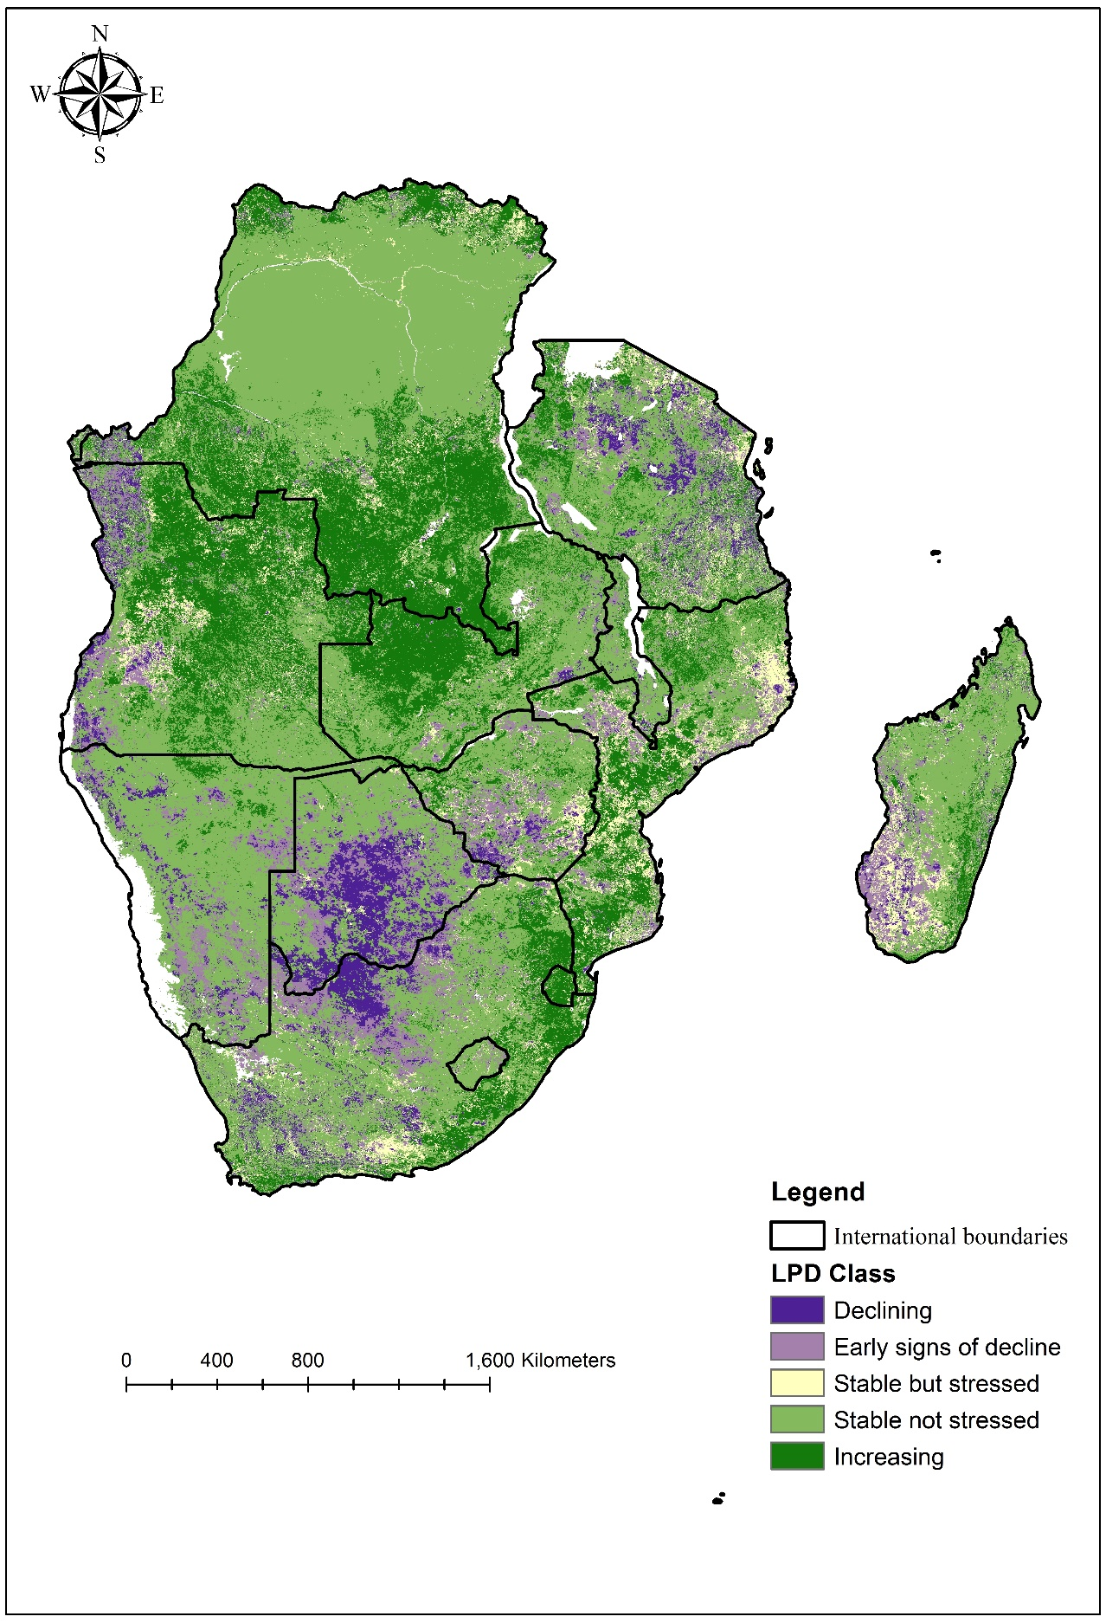
SADC Land Productivity Dynamics
6% of the sub region is experiencing declining productivity
an additional 9.4% is showing early signs of decline
about half (51%) the land area is stable and not showing any sign of land degradation stress
23% is showing signs of increasing productivity or recovery.
73.3% showed either stable or increasing LPD
Wetland: 5.2% of wetlands showed declining or stressed land
Shrublands /woodlands: 35.3% declined or stressed LPD
Sparsely vegetated: 64.6% had either stable or increasing LPD.
Vegetated areas: 31.9% sparsely vegetated areas showed declining trends or signs of stress.
Settlement areas: 40.2% of the land area showed declining or stressed LPD (highest Pressure).
Forests: Approx. 14.8% under declining or stressed conditions, while 85.2% had either stable or increasing land productivity dynamics.
Agricultural land: 26.7% showed declining or stressed LPD while
73.3% showed either stable or increasing LPD.

Slide 12
 | Soil Organic Carbon (tonnes C/ha at 0-30 cm, ISRIC data) |  |  | [using 2015 land Cover Area]
Land cover type | Mean | SOC % | Standard deviation | Total SOC (Gt C)
Agriculture | 47.09 | 0.92 | 24.03 | 7.958
Forest | 55.71 | 1.09 | 23.40 | 30.421
Grassland | 32.62 | 0.64 | 21.91 | 4.822
Shrubland | 29.39 | 0.58 | 18.66 | 7.457
Sparse vegetation | 16.67 | 0.33 | 13.46 | 0.268
Wetland | 64.078 | 1.26 | 24.36 | 1.259
Settlement | 45.57 | 0.89 | 18.63 | 0.090
Bare area | 15.56 | 0.31 | 16.70 | 0.411
Water | 78.44 | 1.54 | 39.91 | 0.445

Slide 13
Baseline Assessment & Preliminary Findings
Land degradation seems to be widespread and fragmented within each of the countries in the region.
1 % of Agricultural land in the Sub Region show a decrease in productivity, while 1.5 % show early signs of declining productivity
SOC levels are very low, +/- 1 % (should be minimum doubled to 2 %)
The land cover change analysis reveals that forests remained stable between 2000 and 2015 with a slight increase (0.80%) whilst sparse vegetation reduced significantly (14%).
Notably, the area under human settlement increased dramatically by close to 80%.

Slide 14
Baselines Assessment Preliminary Findings
A source of uncertainty in the land cover change detection (particularly for the natural vegetation group) could be seasonality and inter-annual climatic variations (e.g. El Nino).
Differing methodologies and classifications of land cover (e.g. woodland vs shrubland vs forest).
Need for more field and harmonized data collection and analysis specific to the ecosystems and soils of the region.
Region still has significant amount of soil organic carbon stocks as well as woody biomass that needs to be managed sustainably.

Slide 15

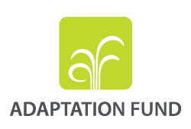
Examples of Opportunities for Funding SADC Land Restoration Projects:
Small, medium and large loans and grants supporting adaptation and mitigation to climate change
Grants for readiness support and national adaptation planning;
Dedicated private sector facility;
All the above implemented direct access and through international access entities; national designated authority and accredited entities
Small grants supporting adaptation to climate change
Technical Assistance for policy dialogue and capacity building on issues related to climate change adaptation
“Implemented through direct access and through multilateral and regional partners (accredited entities), contact national designated authority and accredited entities”

Slide 16
Examples of Available Opportunities for Funding SADC Land Restoration
Small and medium grants supporting global environmental objectives;
Dedicated global funding mechanism for the implementation of UNCCD;
TA for policy dialogue and capacity building on issues like conservation, land degradation, climate;
Implemented by partners, such as UNDP, UNEP, World Bank, and others
Contact national focal points (operational and political) and implementing agencies;
Large investments projects financed mainly through loans, and equity in lesser extent;
The LDN Fund offers long grace period and adapted repayment schedules
Technical Assistance Facility for capacity building and project development;
Project developers can apply, in particular companies, CSOs, smallholders groups, e
Public private partnerships are key to successful LDN Fund investments

Slide 17
Proposed Criteria and Principles for Identification of SADC Land Restoration Programmes
Criteria
Regional impact/result potential,
Replicability and scalability;
Needs of the beneficiary countries;
Country ownership and institutional capacity;
Economic efficiency and
Financial viability/soundness
Partnerships with on-going transboundary initiatives
Principles
Geographical balance;
Ecosystem based approaches,
gender,
Alignment with SADC Regional Cooperation priorities;
Alignment with Rio Conventions,
SDG’s and other international agreements
Participation in Continental programmes such as the Great Green Wall Project, AFR 100 and TerrAfrica

Slide 18
Specific Input Required from the Audience
What would like to see as core components of the LD Investment Framework for the SADC Sub Regional Action Programme to Combat Desertification?
Provide specific examples of LD investment nationally, regionally and internationally.
Share with us the type of instruments that are used to facilitate LD investments in your country or region.
What are the typical major barriers to accessing traditional, non-traditional and innovative financing sources?
Any comments on the proposed criteria and principles for identification of SADC land restoration programmes?
How can your country contribute to the Investment Framework?
Kindly assist with filling in the Survey questioner that will be send to you
For additional information, write Titus at: titus.dlamini0727@gmail.com

Slide 19

Thank You

